Slide 1
VLMs for Autonomous Battle Damage Assessment (BDA)
Mid-Phase II
FEB 23, 2026

Slide 2
VLMs for Autonomous Battle Damage Assessment
Project Overview:
Background
Data Engineering
Modeling
Project Plan
Team Members:
William Benitez: Prompt Engineer
Carlos Gil: Software Developer
Nicholas Lind: Data Engineer
Benjamin Siegel: ML Engineer
Cory Wingate: Project Manager/DevOps
AI2C Scholar and Mentors:
Jesse Barkley: AI Scholar
Derrik Asher: Army Research Lab
Jason Pusey: Army Research Lab

Slide 3
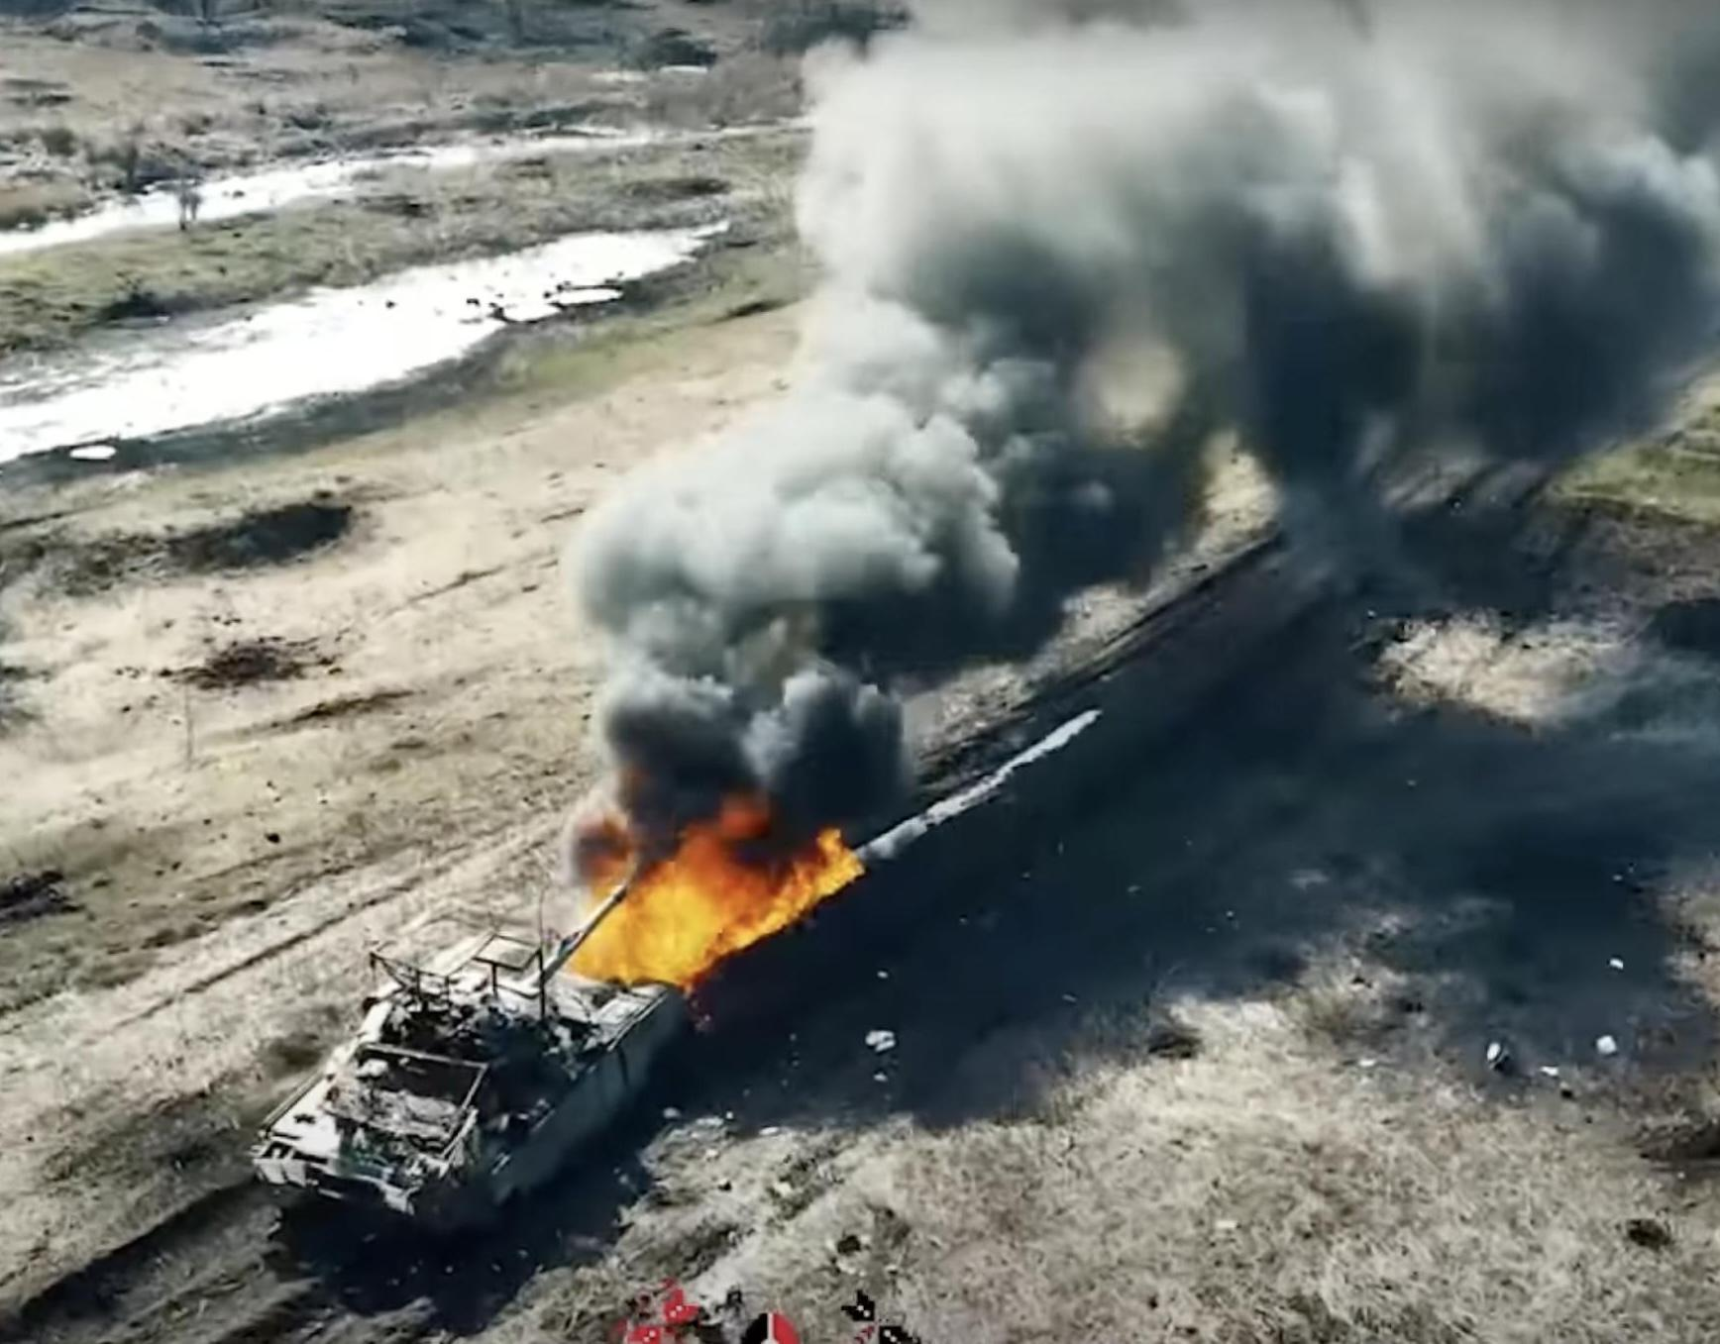
Background - Problem Set
A Battle Damage Assessment (BDA) “provides the timely and accurate estimate of damage resulting from the application of lethal and nonlethal military force.”
(Methodology for Combat Assessment - Joint Staff)
Requires Human Analyst
Slow
Dangerous
Inconsistent, Not Standardized
Notes:
Doctrine defines a BDA as the timely and accurate estimate of damage resulting from lethal and nonlethal military force. That estimate drives the commander’s reattack decision and shapes follow on targeting and maneuver. From a single snapshot, an analyst can capture obvious physical effects and produce initial BDA inputs. However, the current process still depends on trained analysts applying human judgment, which is manpower intensive, subjective, and does not scale in high tempo operations. The comprehensive nature of BDA makes it slow; large volumes of reporting can overwhelm analysts and delay decisions. Errors in the process can become dangerous when commanders demand high confidence and teams must push for additional collection in contested environments. Finally, BDA Outputs are also inconsistent and not standardized across analysts and organizations, leading to uneven quality, duplicate reporting, and friction during reconciliation.

Slide 4
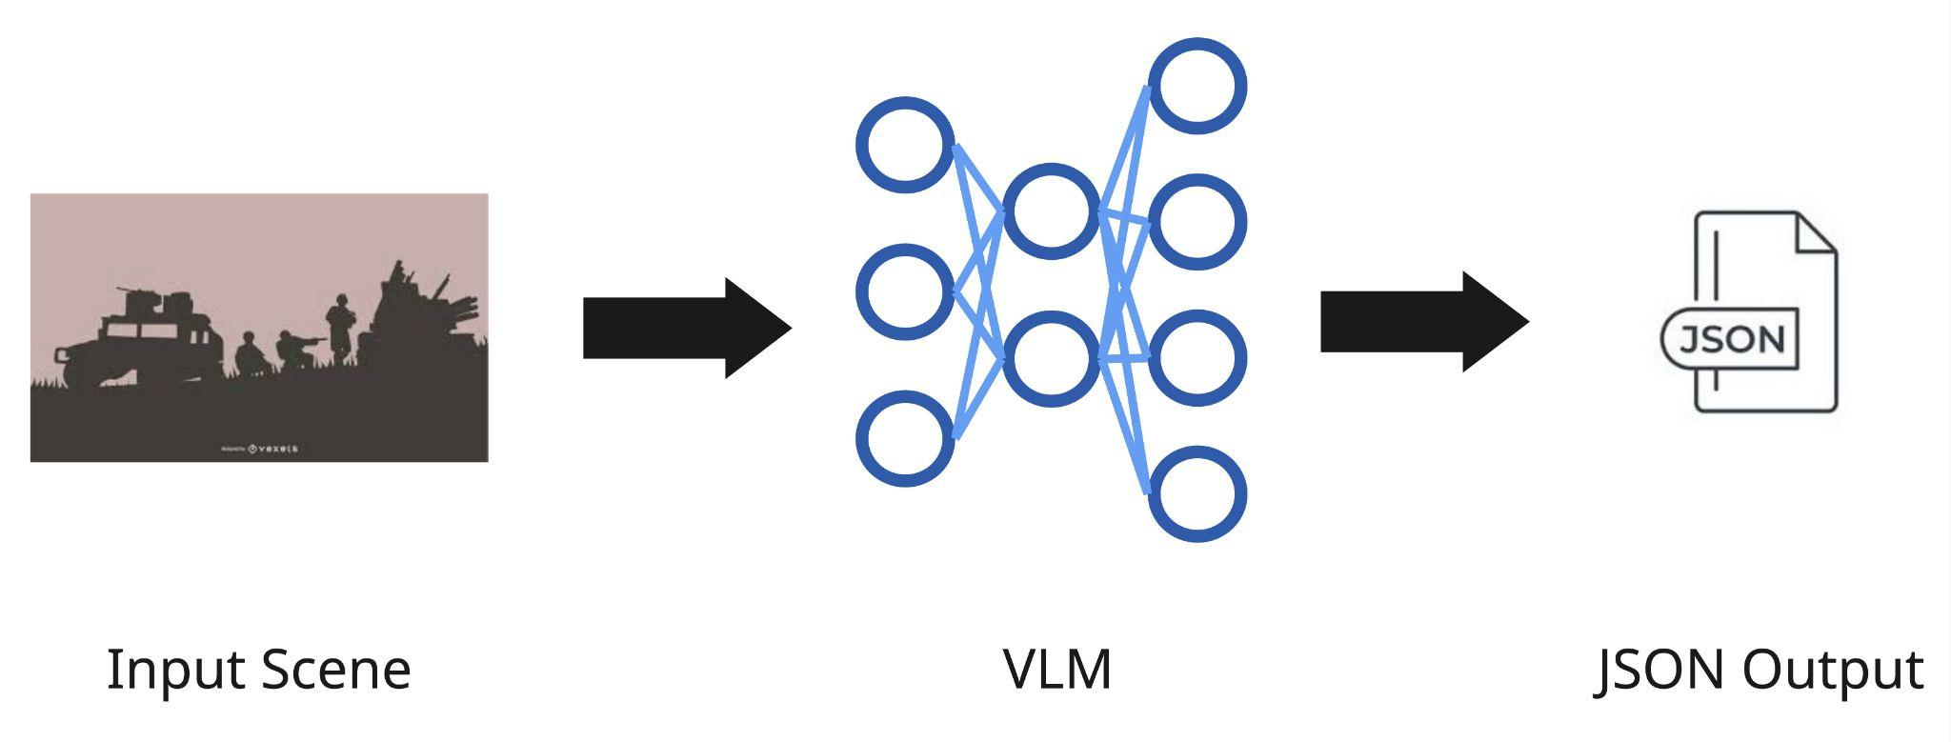
Background - Current Methodology
Problem #1: Vague doctrinal adherence
Problem #2: How good is the model?
Problem #3: Jupyter Notebooks
Notes:
The current method by ARL takes a single image, feeds it to a VLM, and outputs a JSON report.
Challenges that have been previously faced by the ARL team: If the prompt and schema are not aligned to doctrinal definitions, phases, and confidence rules, the output can drift from while still seeming authoritative. Understanding the Model quality and evaluation is critical because you must measure accuracy and calibrate confidence on the mission dataset, or mistakes and hallucinations will scale fast. Jupyter notebooks add delivery challenges through weak repeatability, making outputs harder to reproduce, audit, and version.

Slide 5
Proposed Solution
We are objectively evaluating VLM-generated BDAs using open-source data, as well as developing a portable environment to create VLM-generated BDAs on edge devices operating within research environments.
Notes:
To tackle these challenges, we are objectively scoring VLM generated BDAs to measure accuracy, doctrinal alignment, and failure modes as well as developing a portable, offline environment for edge devices in research settings with pinned dependencies and repeatable execution, so BDA outputs are reproducible, versioned, and traceable.

Slide 6
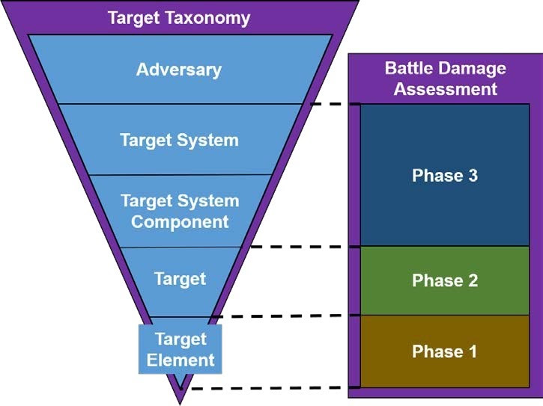
Data Requirements For BDA - VLM Focused
Target-Element Type
Damage Category
Confidence Level
“One vehicle is assessed as DESTROYED (CONFIRMED)”
Notes:
We are focusing the VLM on Phase 1 BDA, the initial, time sensitive physical damage assessment immediately after a strike. Phase 1 is where imagery is most useful because it captures observable effects like fire, smoke, wreckage, and structural collapse, and it is often based on single source reporting. We focus on the VLM reporting on the target element identifier, the Phase 1 physical damage category, and provide a confidence level tied to what is visible in the image according to doctrine.
The Target reported are objects identified in the scene of military importance, example: building, military vehicle, military equipment, bridge, road, etc
Phase 1 Physical Damage can range from:
NO DAMAGE - No apparent/observable damage.
LIGHT DAMAGE
MODERATE DAMAGE - All spans intact, but one or more spans damaged.
SEVERE DAMAGE
DESTROYED
Confidence is based on 3 levels
confirmed — clear, direct visual evidence (>= 95 percent confidence)
probable — visible but partially obscured or ambiguous (50 to 94 percent confidence)
possible — weak or limited visual indicators (<50 percent confidence

Slide 7
Data Requirements For BDA - Out of Scope
Target System Impact
Recuperation Time
Re-Attack Rec.
Task Assessment
*Requires Mission Context (OPORD) and MOE
Scene Level
Functional Damage Level
*Requires All Source Intelligence Fusion
Notes:
Phase 2 and Phase 3 are where BDA stops being an image problem. Phase 2 estimates functional damage at the scene level and requires all source fusion over time. Phase 3 rolls that forward into target system impact, recuperation time, re attack recommendation, and task assessment tied to mission Measures of Effectiveness and OPORDs. A VLM is not viable for Phase 2–3 from imagery because functional effects are often non observable and the conclusions depend on fused intelligence and mission context. If forced, it will either stay generic or over infer and produce non defensible outputs.
Pass to Carlos

Slide 8







Input
- Model prompt
- Model parameters
bda-svc
- Military Doctrine
- Object types
- Damage
Exception Handling if image is not a supported file format
Notes:
Our system automates Phase 1 of the BDA process and includes limited Phase 2 functionality when the image supports it. This slide shows that transformation: raw image in, structured JSON assessment out, with categories, labels, and confidence scores

Slide 9
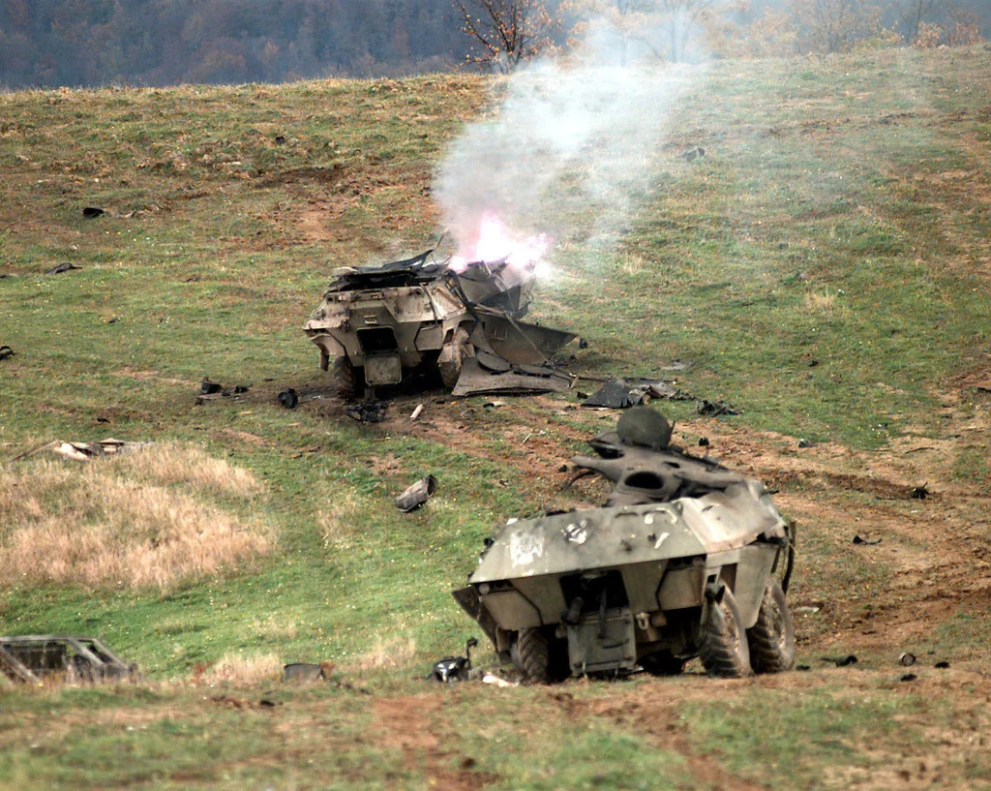
Output
: “ 66608e9e-1f12-409d-8234-0b74a09b844f “,
: " field_multi_mil_042.jpg ",
: " 2026-02-19T20:31:25Z ",
: “ MGRS “,
: " 17T NE 8961 7759 ",
: " PDA ",
: " bda-svc "
: " military_equipment ",
: " DESTROYED ",
: " PROBABLE ",
: " Damaged hull, smoke … "
{
" metadata ": {
" image_id "
“ image_filename ”
" date_created "
" location : {
“crs”
“coordinates”
},
" report_type "
" analyst "
},
" physical_damage " : {
" target_1 " : {
" bounding_box " : {
" xmin ": 314, " ymin ": 256, " xmax ": 555, " ymax ": 433
},
" target_type "
" damage_category "
" confidence_level "
" brief_supporting_logic "
},
" target_2 " : {
. . .
}
}
}
target_1
target_2
Notes:
Our system automates Phase 1 of the BDA process. This slide shows that transformation: raw image in, structured JSON assessment out, with categories, labels, and confidence scores

Slide 10



Software Deliverable
Robotic Platform
Executable / CLI
Validate + Access
Preprocess Targets
VLM Output
Store
Self-contained with software and model
Read input folder
Write output folder
Prompt input
BDA Analysis
JSON Output
Docker Runtime
NVIDIA Jetson

Slide 11
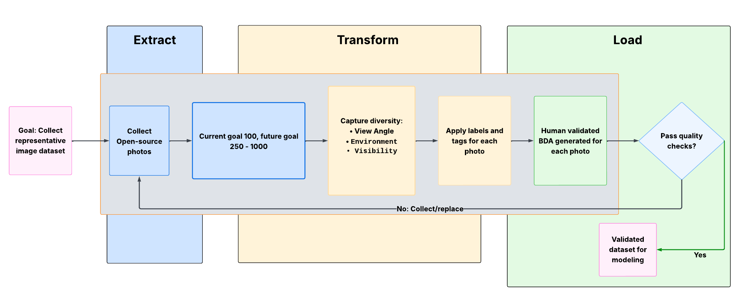
Data
Notes:
We’ve collected 100 open‑source images that cover a wide range of real conflict environments. This gives us a strong starting point for testing and improving our workflow before we scale up. We focused on capturing variety so the dataset reflects the unpredictable nature of real scenes. Each image is labeled, tagged, and organized the same way, and every image gets a human‑written BDA report. That means the dataset isn’t just collected — it’s checked, graded, and ready to use. If an image doesn’t meet our standards, we replace it to keep the dataset clean and reliable. We’re starting with 100 images, but our goal is to grow to 250 and eventually toward 1,000. Overall, this pipeline shows we’re building a repeatable process, not just gathering pictures.

Slide 12
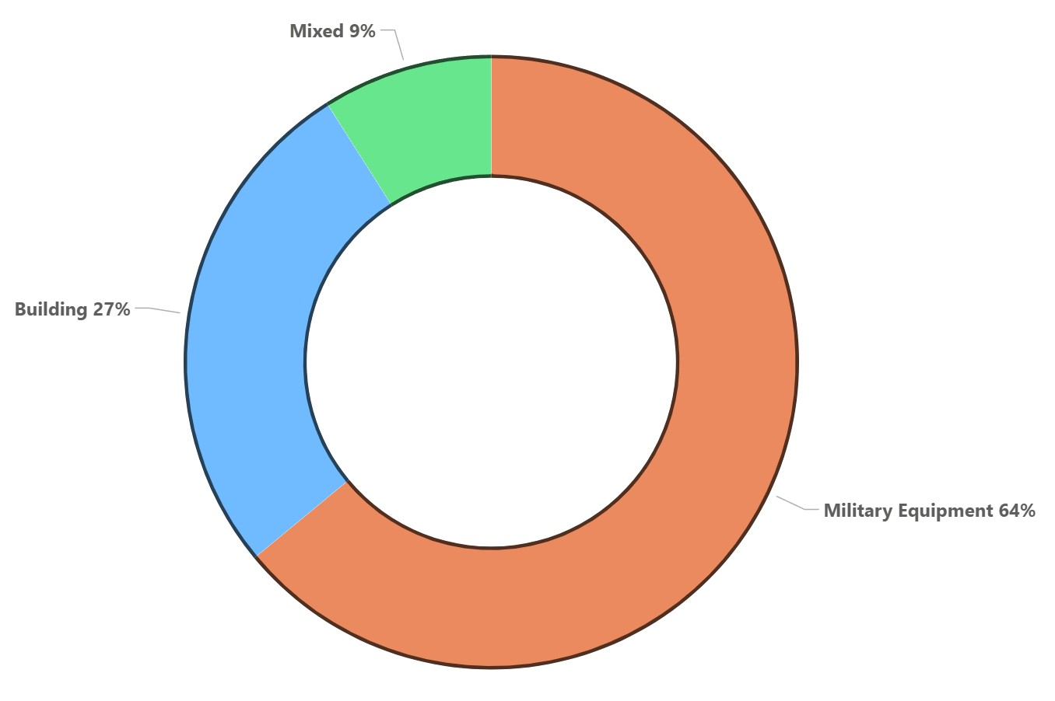
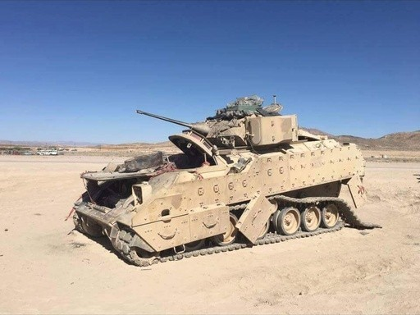
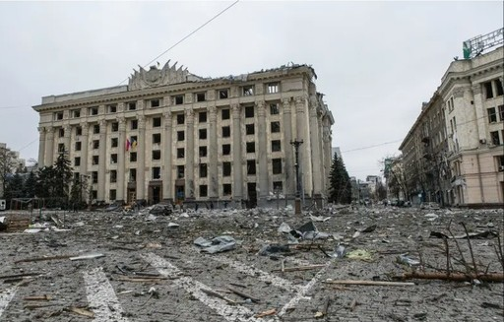
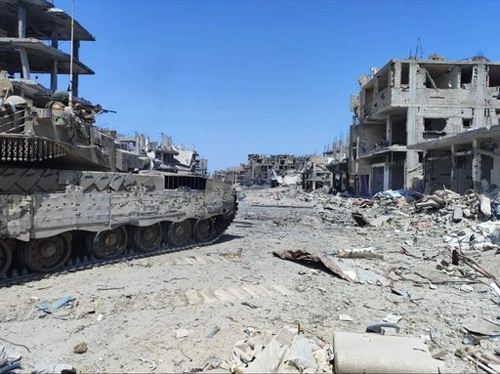
Overall Distribution of Major Categories
Notes:
Our dataset of 100 images is currently weighted towards military equipment. About 27% of the images contain buildings, and another 9% fall into a mixed category that includes both buildings and military equipment. Across all categories, scenes can contain either a single object or multiple objects. The remaining 64% of the dataset consists of images showing only military equipment.
Currently we have only these 3 categories, we plan to expand the dataset to include multiple different types of data. Bridges, dams, bunkers, runways, roads and everything in between.

Slide 13
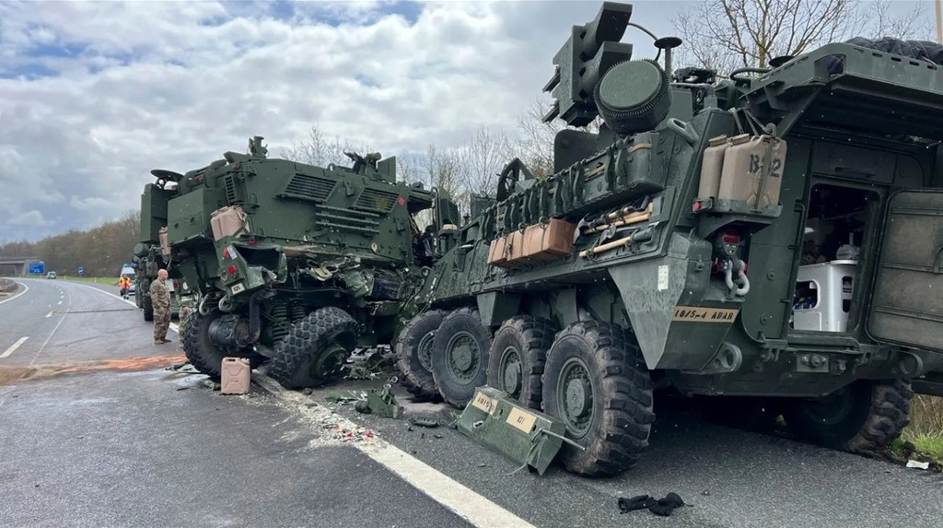
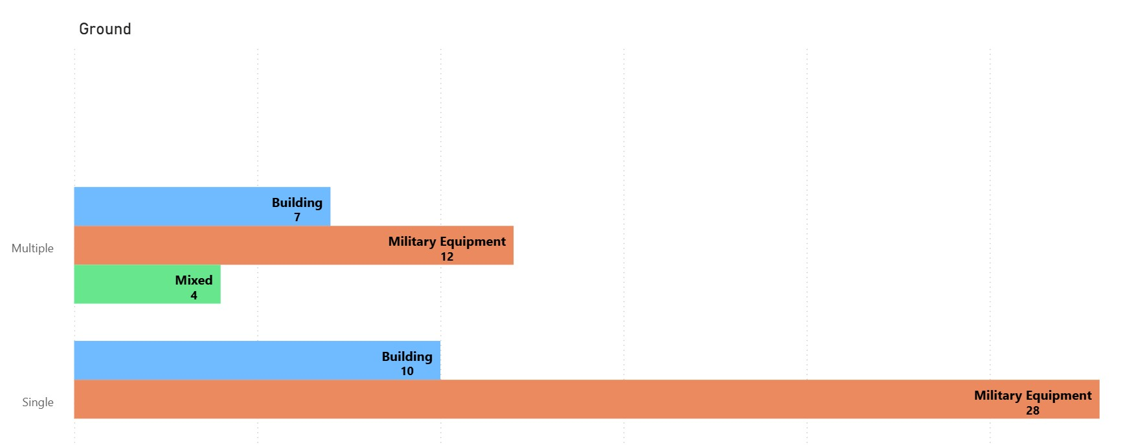
Data Composition by Look Angle
Notes:
Right now in our dataset of 100 images 61 are ground based photos. The set is skewed more towards ground level imagery as an end goal of ours is to deploy on a ground based robotics platform. The top bars represent images that have multiple objects in each image, while the bottom bars represent single target images. Emphasizing ground perspectives ensure the model is trained on the same viewpoint where equipment is most relevant during real world operations.

Slide 14
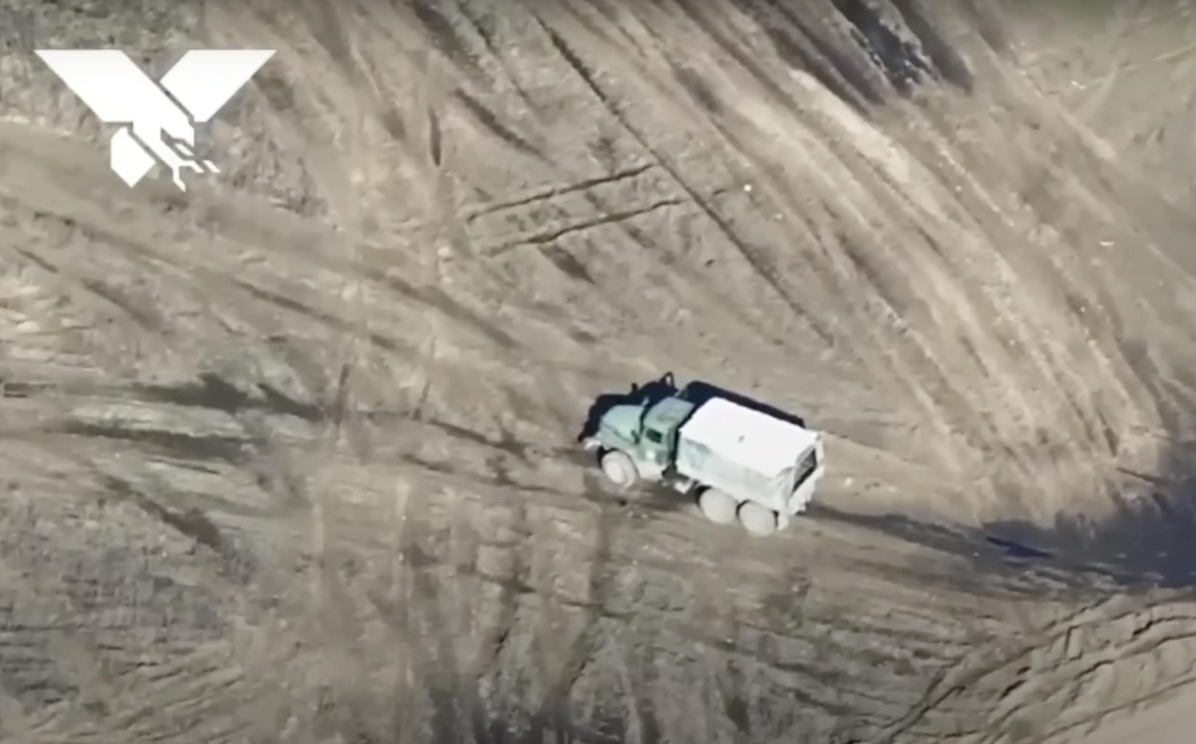
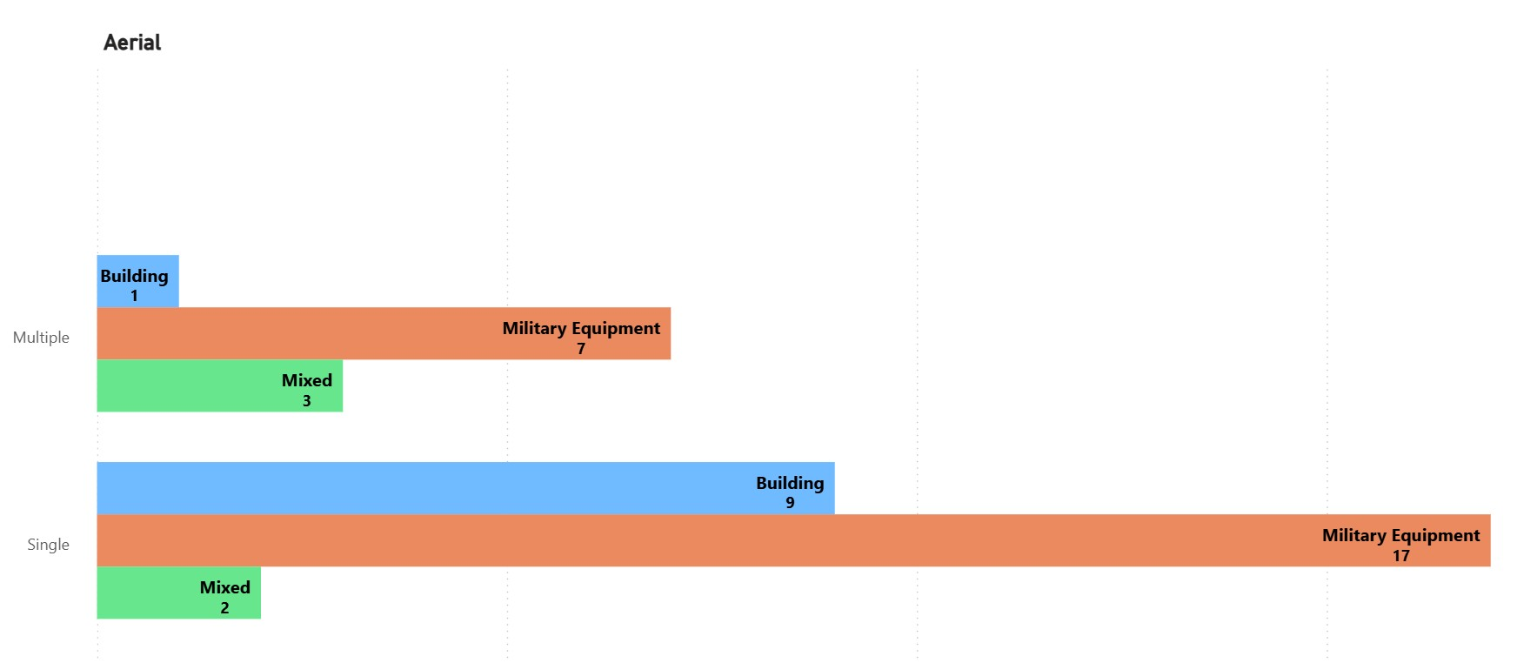
Data Composition by Look Angle
Notes:
The remaining 39 photos in our current dataset of 100 are aerial based imagery. Aerial images make up a smaller part of the dataset, but still help the model see the same categories from a different viewpoint. This will add variety to help the model stay consistent when we run multiple different viewpoints through.

Slide 15
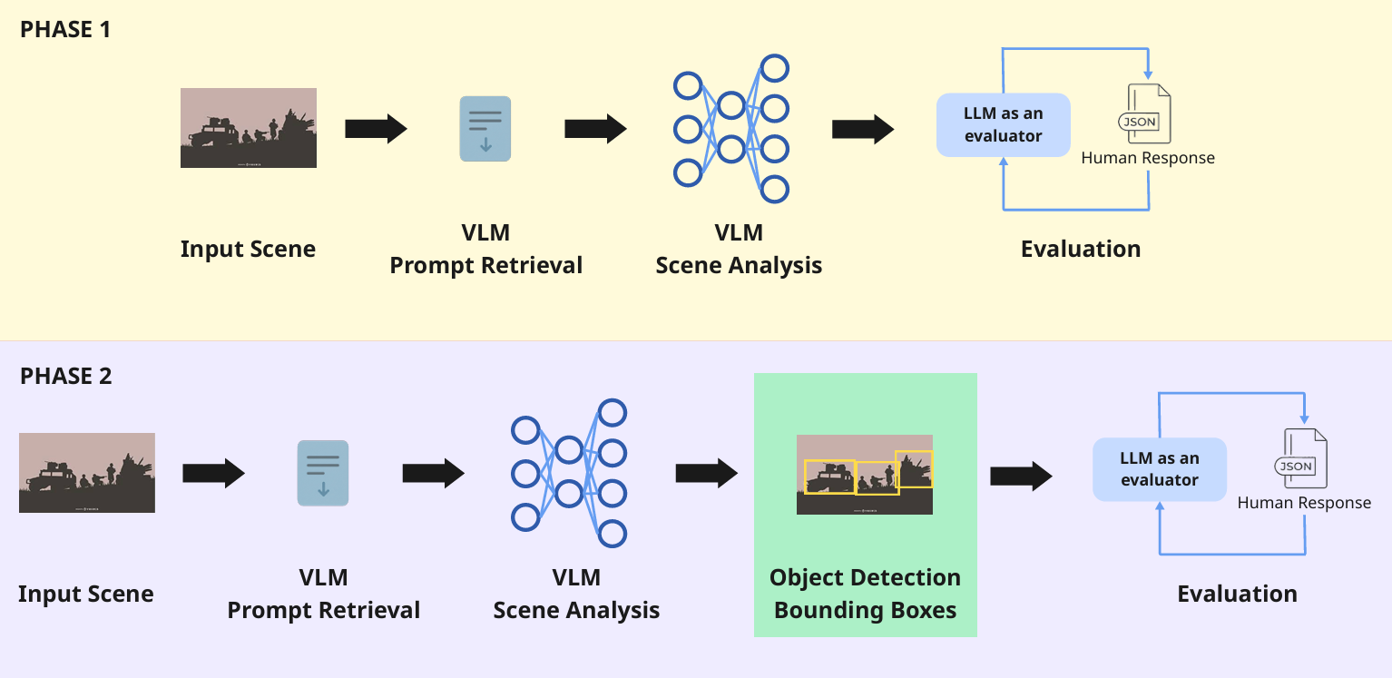
Modeling
Notes:
Current Phase:
Edge device captures input scene
Pass input scene to lightweight VLM, reason about scene, output only the doctrinal categories in the scene
Generate prompt with doctrinal category definitions injected, pass the input scene and full prompt to the VLM
VLM produces an output, which either gets sent to the analyst, or goes into our evaluation pipeline
Future Phase:
Sometimes when an image has many targets, it can be difficult to tell what object in the scene corresponds to what object in the report. It would be nice to have a feature where the model draws an exact bounding box around the objects in the scene to output in the final report. To solve this, we plan on adding a lightweight object detector after the VLM does it’s inference.

Slide 16

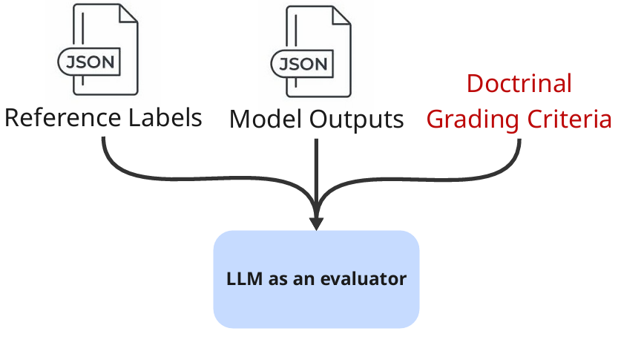
Evaluation
Inputs
Object Matching
Logic Evaluation
Match predicted objects to reference objects by target type.
Compare key attributes:
Damage level
Confidence
Penalize:
Missed objects
Extra objects
Reference Labels
Model Outputs
Target type
Damage level
Confidence
Supporting logic
Produce logic quality scores.
Final Score = Structured Accuracy - Detection Penalties + Logic Quality
Notes:
For the purpose of the edge device, the model simply outputs a report and we are done.
However, a major goal of this project is rigorous evaluation – how do we know how well the model performs?
Our evaluation approach uses a custom metric to evaluate all aspects of the report:
Identifying the presence of individual targets in the scene
The correct doctrinal target type, damage level, and confidence level
The natural language – evaluating the written logic to support these fields
We use an object matching approach to parse fixed categories such as the target type, damage level, and confidence level.
We use an llm as a judge approach to evaluate the written logic.
The final score for each image is the combination of the structured accuracy minus any penalties for hallucinations or missed objects plus the llm as a judge logic quality.

Slide 17
Plan
Milestone 1 08FEB26
Milestone 2 15MAR26
Milestone 3 12APR26
Milestone 4 05MAY26
Milestone 5 11MAY26
Requirements, Design, Planning
Model Evaluation, Robotic Testing
Project Presentation
Dataset Analysis, Labeling, Model Design
Pipeline Validations, Containerization
- Problem statement
- Requirements
- Design Plan
- Phase 1 Documents
- Dataset Identification
- Data Labeling
- Pipeline/Model Dev
- Phase 2 Documents
- Prompt Finalization
- Pipeline Validation
- Container Dev
- Phase 3 Documents
- Evaluation Execution
- Results Analysis
- Robotic Deployment
- Phase 4 Documents
- Final Presentation
- Artifact Submissions

Slide 18
Challenges
Integration of Phase 2 Functional Damage Assessment (FDA)s
Insufficient details
16GB GPU VRAM Limits Model Size
Approximate 8B limit
Mitigation: Testing Quantization Reductions

Slide 19
Questions?

Slide 20
Hidden Slides

Slide 21
Data Requirements For BDA
Recuperation Time
Re-Attack Rec.
Task Assessment
Requires Mission Context (OPORD)
Notes:
Phase 3 is the target system assessment. It consolidates Phase 1 and Phase 2 reporting over time and estimates system level impact on a deliberate battle rhythm. This is where recuperation time, reattack recommendation, and task assessment require mission context tied to measures of effectiveness and planning products like the OPORD. A VLM is not viable for Phase 3 because answers depend on all source analysis and mission context, not image interpretation. If forced, it will either stay generic or produce non defensible system level conclusions.

Slide 22
BDA Pipeline - Process Flow Diagram
Local Dev Environment
Research / Testing
CLI + Config
Validate Input
Preprocess
VLM Analysis
JSON Output
Iterate to validate
end-to-end behavior
• Start VLM-only baseline
• Then add object detection
• Refine prompts/templates
Select VLM + prompt
via text config
Folders + usage
JPG/PNG/GIF/TIFF
Object extraction
Quality checks
Log & continue
Assess physical +
functional damage
Report: date, model,
damage, confidence,
observations, images
Robotic Platform
Deployed
Executable / CLI
Validate + Access
Preprocess Target
VLM Target
Persist + Retrieve
Production execution
Constraints
• .py file or container image
• No network required
• Console progress %
Linux
system-wide
Read input folder
Write output folder
< 3s / image
(preprocessing)
< 15s / image
16 GB VRAM
Standards JSON
No overwrite/delete
Retrieve via CLI arg
Inputs & Configuration
Outputs
Edge Cases & Constraints
CLI args: usage, input folder, output folder
Validate data presence + formats
Choose VLM + prompt via text config
JSON report + supporting imagery
Notify user + output location
Retrieval mode for completed assessments
Invalid/corrupt → notify; continue or re-run
Low confidence → flag; manual review/reprocess
System failure → log; alert admin; retry later
Offline, no external deps, ≤ 20 GB footprint

Slide 23
Future Work
Dataset Expansion
Model Evaluation Pipeline
Prompt Tuning
Object Detection Integration
Comprehensive Pipeline Testing
Docker Image Development

